Slide 1
Stanton Community Schools 7-12 In-Service
Presented by
Marissa Payzant
English Language Arts Specialist
Nebraska Department of Education

Slide 2
Introductions
Name
Grade Level
Years of service
What you hope to learn more about today

Slide 3
Today’s agenda
The instructional shifts
What is the Opportunity Myth?
Text complexity
Qualitative, quantitative, and reader & task considerations
Close reading strategies
Partner paraphrasing
Chunking strategy
The role of disciplinary literacy
Vocabulary in speaking & listening

Slide 4
Nebraska Instructional Materials Collaborative
Because materials matter for all Nebraska students…

Slide 5
Standards revision timeline

Slide 6
Identify a significant “shift” in your content area’s standards.

Slide 7
Instructional shifts in literacy

Slide 8
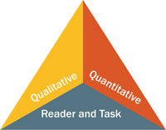
ELA Shift #1
Text complexity—building knowledge with complex informational and literary text and its academic language; range and volume of text

Slide 9
ELA Shift #2
Evidence—reading, writing, and speaking grounded in evidence from text

Slide 10
ELA Shift #3
Background knowledge—building students’ content knowledge systematically with rich and complex informational texts in all content areas

Slide 14
The Opportunity Myth

Slide 15
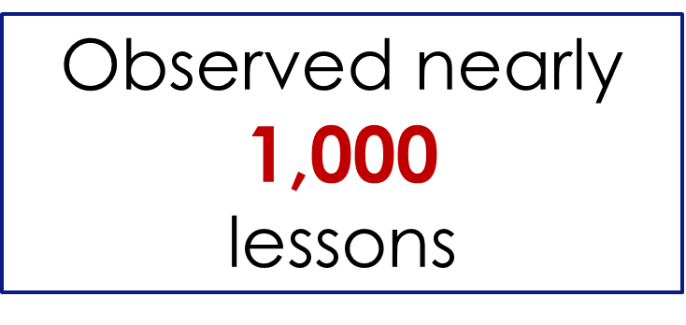
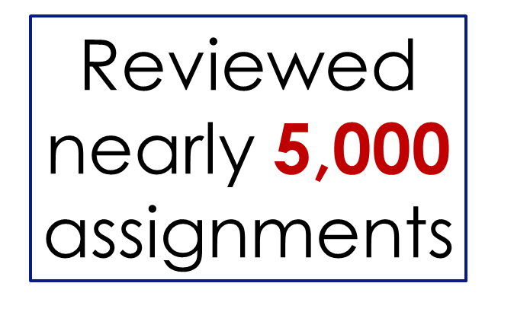
The Opportunity Myth
Partnered with FIVE
diverse school systems.

Slide 16
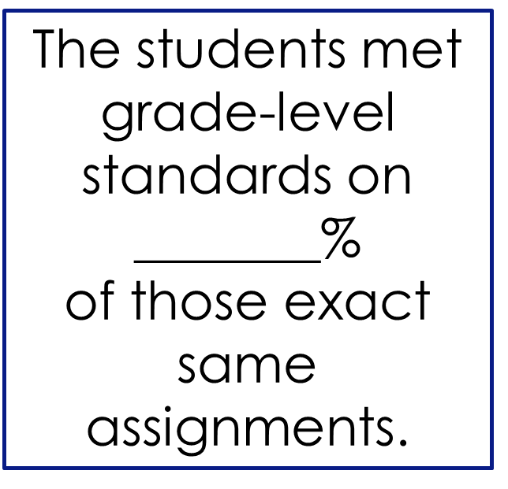
The Opportunity Myth

Slide 17
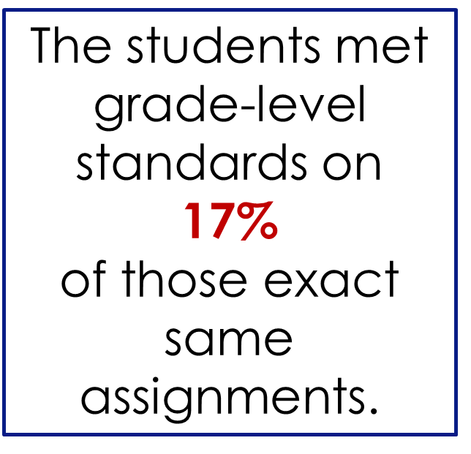
The Opportunity Myth

Slide 18
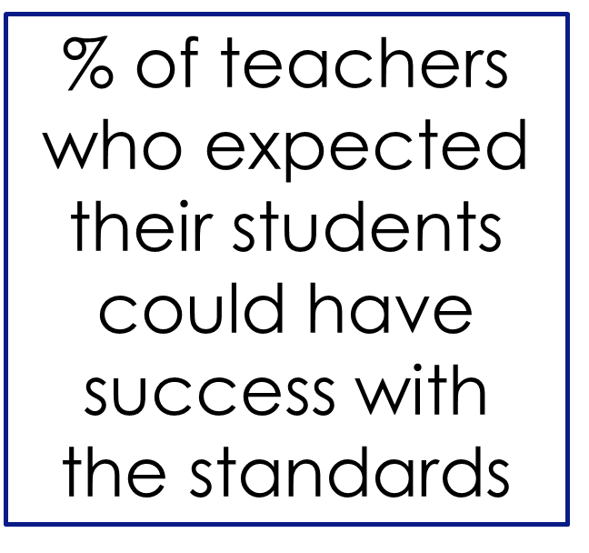
The Opportunity Myth

Slide 19
What is the opportunity myth?
If students do what they’re asked to do in school, they will be successful
(e.g. ready for college and career)
This does not ring true for all students!

Slide 20
Student work library
What’s the difference between high and low-quality assignments?
How well do assignments align to college and career-ready standards?
Strongly aligned, partially aligned, weakly aligned
Content, practice, relevance
ELA: Text complexity & quality, grade appropriateness, text dependent & text specific questions (evidence from text), reading with purpose
MATH: Procedural, conceptual, or application tasks, aspects of grade-appropriateness rigor, Standards for Mathematical Practice

Slide 22
870L 880L

Slide 23
Qualitative features of text complexity
Meaning
Is the purpose of the text obvious?
Does the text have more than one meaning?
Structure
How is it organized?
Are graphics, if present, helpful?
Does it contain new or unfamiliar text features?
Language
What kinds of literal and figurative language are present?
Is the language temporary or archaic?
Knowledge
How much background knowledge must the reader have to access this text?

Slide 24
Reader and task considerations
Student learning needs, abilities, and interests
Motivation and engagement
Prior knowledge and experience
Maturity
Task concerns

Slide 26
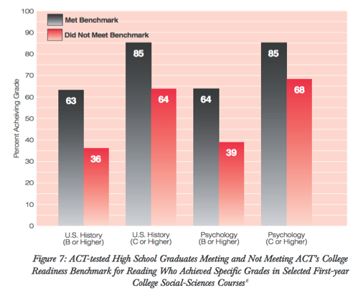
ACT Report (2006): Reading Between the Lines
College readiness defined as
meeting benchmark ACT reading score

Slide 27
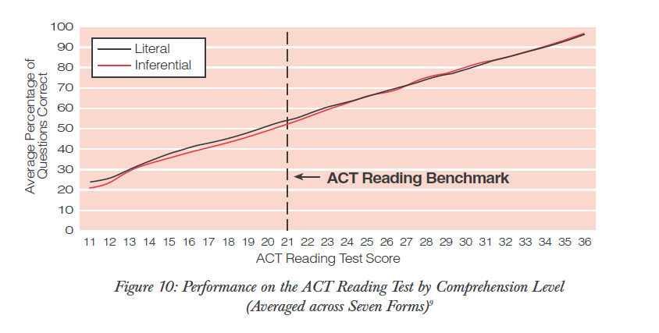
Students who can read literally, can read inferentially

Slide 28
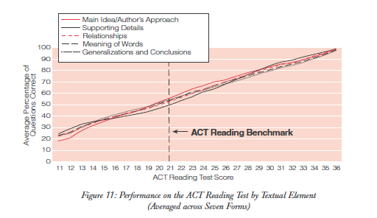
Students who can perform one strategy can perform all strategies

Slide 29
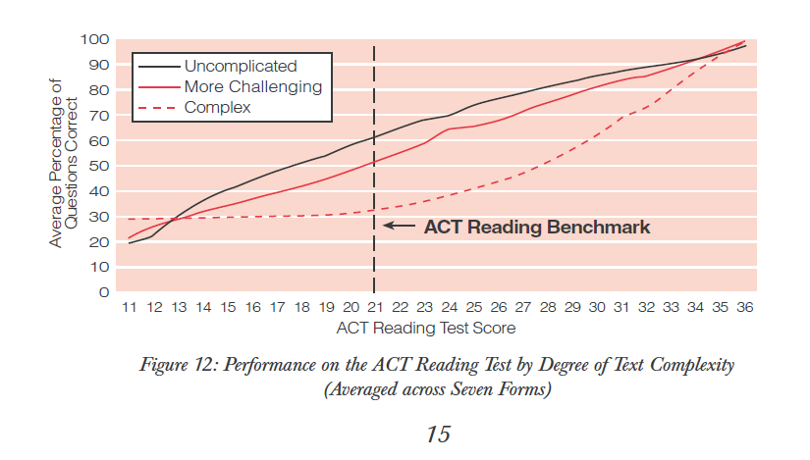
Ability to read complex text differentiates college-ready readers

Slide 31
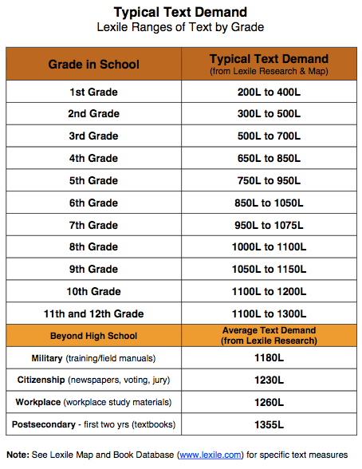

Slide 34
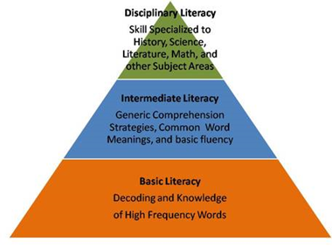
Disciplinary Literacy

Slide 35
The cells that line the nasal cavities have cilia, tiny hairlike extensions that can move together like whips. The whiplike motion of these cilia sweeps the mucus into the throat, where you swallow it. (Science Voyages, 2000a, p. 558)

Slide 36
Science text reading
Sentence density; tightly packed information
Technical and abstract (no interactive or interpersonal style)
Nominalization, or turning processes into nouns, ex. Ecosystem destabilization can be the consequence of invasion.
Unpacking complex nouns
Experimental verification of Einstein’s explanation of the photoelectric effect was made 11 years later by the American physicist Robert Millikan. Every aspect of Einstein’s interpretation was confirmed, including the direct proportionality of photon energy to frequency.

Slide 38
Math/word problem reading
Consideration of every word in the text—”close reading”
Translation of symbols and expressions
Use of passive voice
Re-reading
Precision of understanding is critical
Rethinking use of “key words”

Slide 39
By 1929, American factories were turning out nearly half of the world’s industrial goods. The rising productivity led to enormous profits. However, this new wealth was not evenly distributed. (Beck, Black, Krieger, Naylor, & Shabakam, 2003, p. 423)

Slide 40
History text reading
Authors & their sources are critical to interpretation (use of a single text problematic)
Narrative without purpose; argumentative without claims
Construction of time, place, and causation via prepositional phrasing
Over the next decade, events led to war.
They gathered in Philadelphia.
They made enemies by their harsh stands.
Cause & effect (agency/hidden actors)
Judgment and interpretation

Slide 41
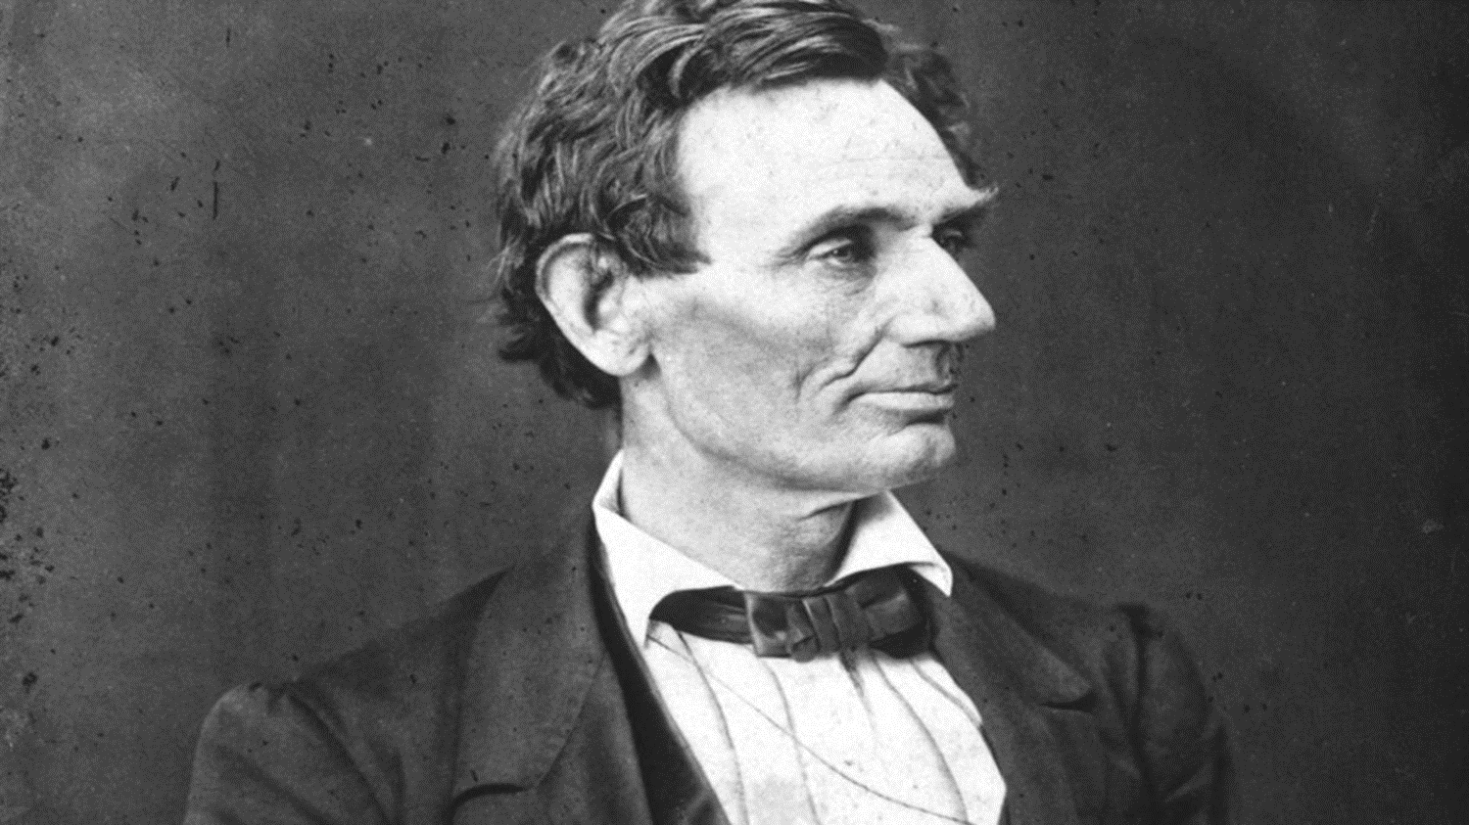
Partner paraphrasing

Slide 42
Chunking strategy (lines 47-52)
If we shall suppose that American slavery is one of those offenses which, in the providence of God, must needs come, but which having continued through his appointed time, He now wills to remove, and that He gives to both North and South this terrible war as the woe due to those by whom the offense came, shall we discern therein any departure from those divine attributes which the believers in a living God always ascribe to him?

Slide 43
Chunking strategy (lines 47-52)
If we assume that slavery was an evil which God allowed to happen, BUT he has now decided that it’s time to end it, AND the war is his punishment on both the North and the South for the role they played in evil, does that mean God was unfair or unjust?

Slide 44
Analyzing text complexity

Slide 45
Thank you!

