Slide 1
Stanton Community Schools K-6 In-Service
Presented by
Marissa Payzant
English Language Arts Specialist
Nebraska Department of Education

Slide 2
Introductions
Name
Grade level
Years of service
What you hope to learn more about today

Slide 3
Today’s agenda
SAP Wonders Adaptation debrief
The Opportunity Myth
ELA instructional shifts
Text complexity overview
Qualitative, quantitative, and reader & task considerations
Language Dive close reading strategy
Analyzing text complexity
Vocabulary in listening & speaking

Slide 4
Nebraska Instructional Materials Collaborative

Slide 5
The Opportunity Myth

Slide 6
The Opportunity Myth
Partnered with FIVE
diverse school systems.
Observed nearly 1,000
lessons
Reviewed nearly 5,000 assignments
Analyzed more than
20,000
student work samples.
Collected nearly 30,000 student surveys

Slide 7
The Opportunity Myth
Students succeed on
_______%
of their assignments.
The students met grade-level standards on
_______%
of those exact same assignments.

Slide 8
The Opportunity Myth
Students succeeded on
71%
of their assignments.
The students met grade-level standards on
17%
of those exact same assignments.

Slide 9
The Opportunity Myth
% of teachers who support the content of their state’s academic standards
% of teachers who expected their students could have success with the standards
82%
44%

Slide 10
What is the “opportunity myth?”
If students do what they’re asked to do in school, they will be successful (e.g. ready for college and career).
This does not ring true for all students!

Slide 11
Student Work Library
What’s the difference between high and low-quality assignments?
How well do assignments align to college and career-ready standards?
Strongly aligned, partially aligned, weakly aligned
Content, practice, relevance
Text complexity & quality, grade appropriateness, text dependent & text-specific questions (evidence from text), reading with purpose

Slide 13
Instructional shifts in literacy
Text complexity—building knowledge with complex informational and literary text and its academic language; range & volume of text
Evidence—reading, writing, and speaking grounded in evidence from text
Specialized research skills—writing for various purposes and audiences across disciplines

Slide 14
Reflection on the instructional shifts

Slide 15
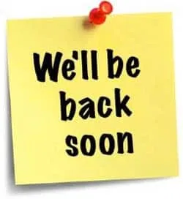

Slide 16
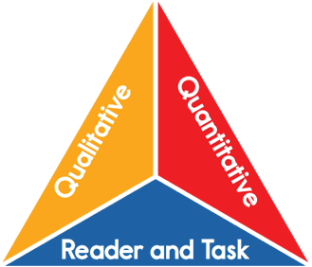

Slide 17
Text complexity ranking activity (least complex=1, most complex=8)
Frindle by Andrew Clements
Where the Wild Things Are by Maurice Sendak
Because of Winn-Dixie by Kate DiCamillo
The Giving Tree by Shel Silverstein
Green Eggs and Ham by Dr. Seuss
If You Give a Mouse a Cookie by Laura Joffe Numeroff
Diary of a Wimpy Kid by Jeff Kinney
Curious George by H.A. Rey

Slide 18
Text complexity ranking activity
1. Green Eggs and Ham by Dr. Seuss 210L
2. Curious George by H.A. Rey 330L
3. If You Give a Mouse a Cookie by Laura Joffe Numeroff 410L
4. The Giving Tree by Shel Silverstein 530L
5. Because of Winn-Dixie by Kate DiCamillo 670L
6. Where the Wild Things Are by Maurice Sendak 740L
7. Frindle by Andrew Clements 830L
8. Diary of a Wimpy Kid by Jeff Kinney 950L

Slide 19
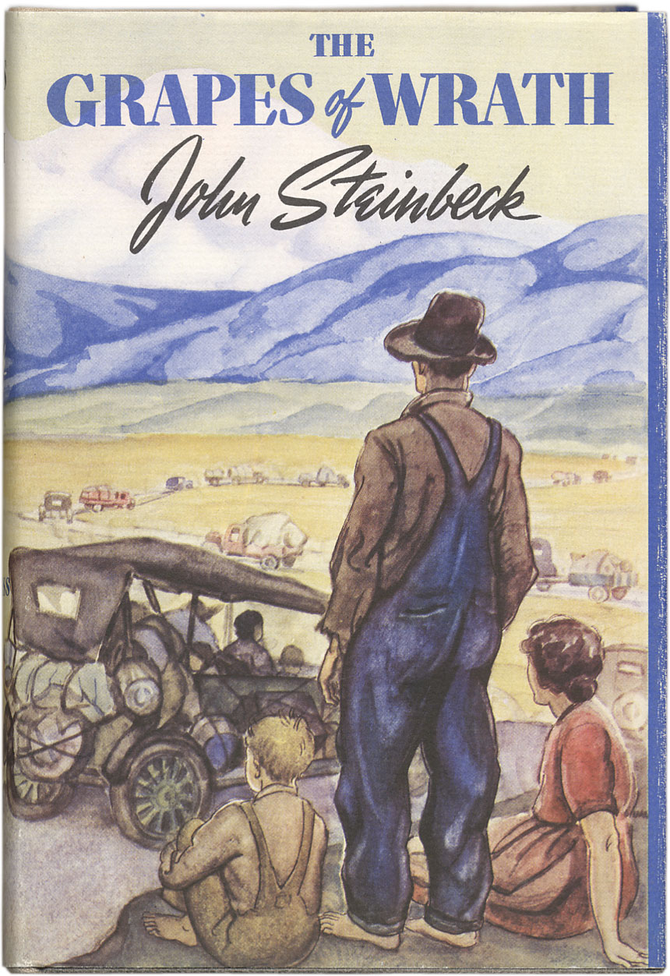
680L

Slide 20
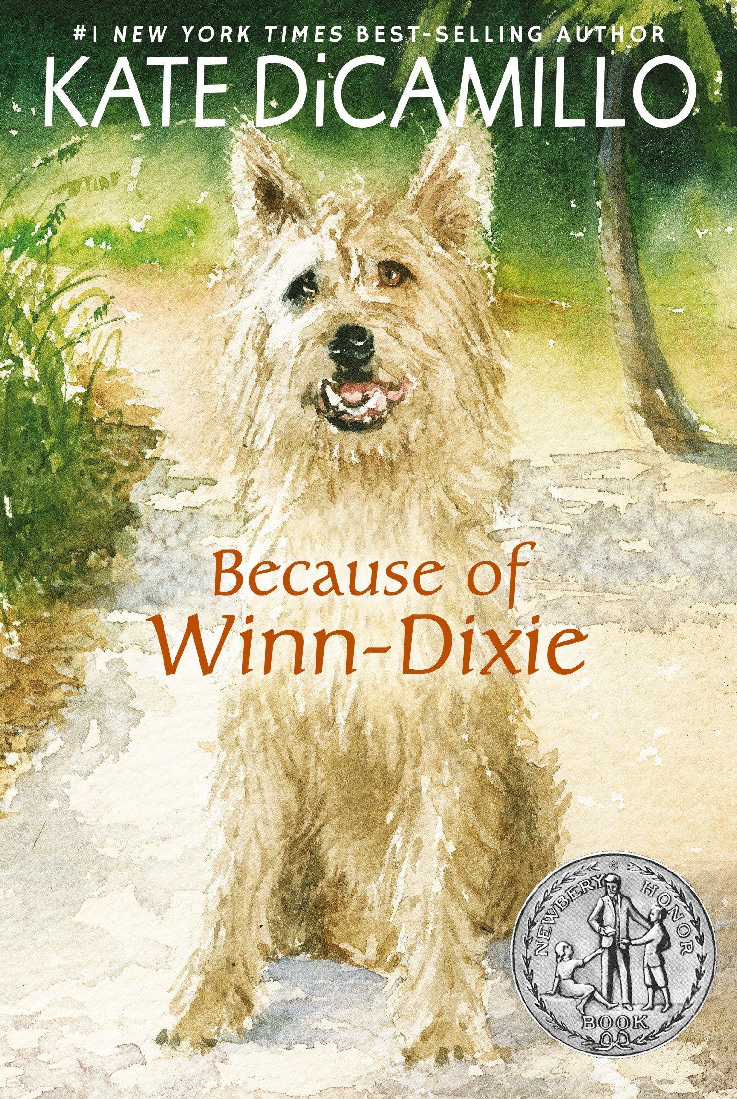
670L

Slide 21
There is more to be learned from challenging texts, but this means that there needs to be a lot more teaching with such texts. Instead of asking what book level to teach someone at, teachers should ask, “If I place a student in a book this challenging, how much support will I need to provide to enable him/her to learn from this text? -Timothy Shanahan

Slide 22
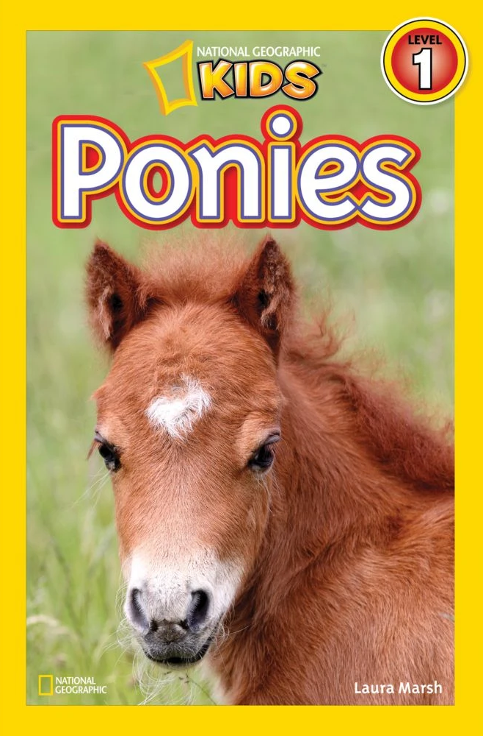

Slide 24
Language Dives

Slide 25
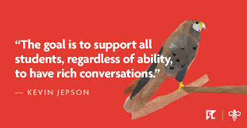
Language Dives
a 10-20 minute guided conversation about the meaning, purpose, and structure of a compelling sentence from a complex text
3 basic steps:
Deconstruct, reconstruct, and practice

Slide 26
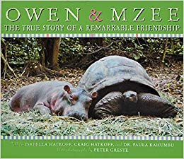

Slide 27
What is the meaning of this sentence? Why do we think that?

Slide 28
What does the phrase “least expected” mean? What is a synonym?

Slide 29
Which animal, Owen or Mzee, do you think found the friendship to be more unexpected?

Slide 30
What is “the heart” in this sentence?

Slide 31
What are some of the scientific theories behind Owen and Mzee’s friendship?

Slide 32
How can we say this sentence in our own words?

Slide 33
Can we split this sentence into two or more sentences? What do we need to remove or change?

Slide 34
Can we say this sentence in a different order? How?

Slide 35
What kind of special punctuation has the author used? What is its purpose?

Slide 36
Which words are emphasized when this sentence is read aloud?

Slide 37
How is Owen and Mzee’s friendship similar to that of Opal and Winn Dixie’s?

Slide 38
Practice…
But the hippo enjoyed grazing the grasses along the shore and in the villagers’ yards.
But they would take good care of him in Haller Park.
But Owen became angrier than ever and charged at the people gathered around.
But Owen, who could easily keep up with the old tortoise, did not give up.
But it was clear that the bond between Owen and Mzee was helping the baby hippo to recover from being separated from his mother and stranded in the sea.

Slide 39
Practice…
Owen and Mzee bonded because ________________.
Owen and Mzee bonded but ______________________.
Owen and Mzee bonded so _______________________.

Slide 40
Appositive phrases
Owen, ____________________, lived in a pod of about twenty other hippos.
Mzee, _____________________, now shared his enclosure with Owen.
Kenya, ____________________, is home to Sabaki River.
a 130-year-old giant tortoise
A baby hippopotamus
a nation on the east coast of Africa

Slide 41
Standards

Slide 43
Vocabulary in Speaking & Listening

Slide 44
Thank you!

